Slide 1
Design patterns unit-1
M.tech SE.

Slide 2
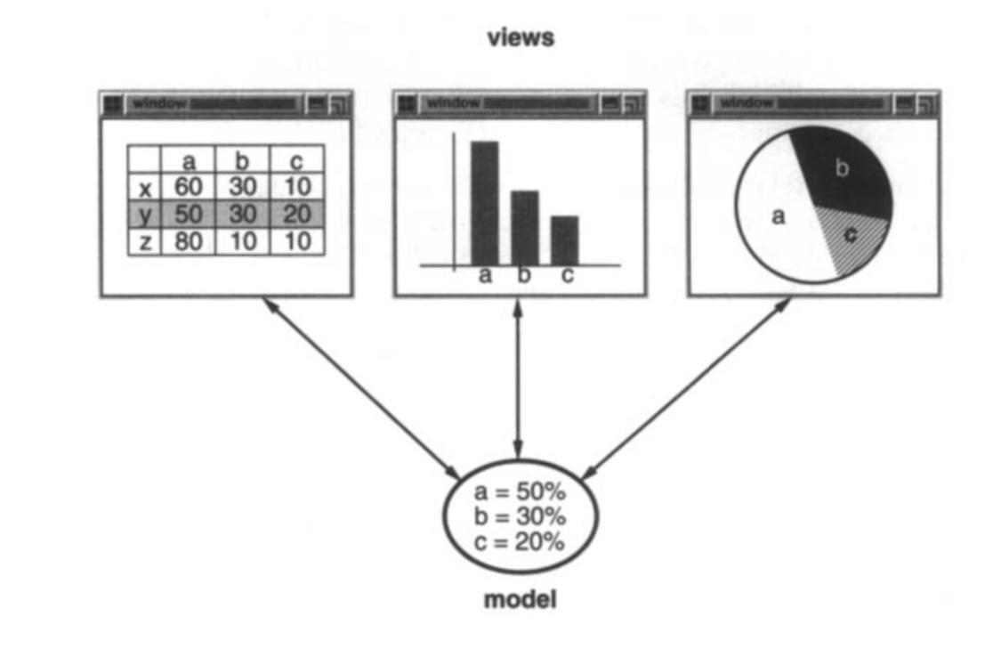
In the last class we have seen the introduction to design patterns and have seen the smalltalk MVC.
Now let's once again see design patterns in smalltalk MVC.
MVC divides a program into three main components:
Model – This is where the actual data and logic of the application live. It represents the real thing the program is dealing with.
Example: In a text editor, the model stores the actual text.
View – This is responsible for displaying the data to the user. It takes information from the model and presents it visually.
Example: The window in the text editor where you see the text.
Controller – This handles user interactions like mouse clicks and keyboard input, translating them into actions for the model and view.
Example: Pressing a key in the text editor triggers the controller to update the model (add a character) and update the view.

Slide 3
Smalltalk’s implementation of MVC was unique because it introduced a few additional ideas:
Observers: The view doesn’t ask for updates from the model—it gets notified whenever the model changes. This is done using the Observer pattern.
Multiple Views: Different views can display the same data. For example, in a spreadsheet app, one view might show a graph while another shows a table.
Active Controllers: Controllers manage user input dynamically and change behavior based on user actions.
And shall help in:
Separation of Concerns: The program is easier to manage and update.
Reusability: Views and controllers can be reused for different models.
Scalability: It makes it easier to add new features without breaking the existing structure.

Slide 4
Describing Design Patterns
How do we describe design patterns? Graphical notations, while important and useful, aren't sufficient. They simply capture the end product of the design process as relationships between classes and objects. To reuse the design, we must also record the decisions, alternatives, and trade-offs that led to it. Concrete examples are important too, because they help you see the design in action.
We describe design patterns using a consistent format. Each pattern is divided into sections according to the following template. The template lends a uniform structure to the information, making design patterns easier to learn, compare, and use.

Slide 5
Pattern Name and Classification
The pattern's name conveys the essence of the pattern succinctly. A good name
is vital, because it will become part of your design vocabulary. The pattern's
classification reflects the scheme we introduce.
Intent
A short statement that answers the following questions: What does the design
pattern do? What is its rationale and intent? What particular design issue or
problem does it address?
Also Known As
Other well-known names for the pattern, if any.
Motivation
A scenario that illustrates a design problem and how the class and object structuresin the pattern solve
the problem. The scenario will help you understand the more abstract description of the pattern that follows.

Slide 6
Applicability
What are the situations in which the design pattern can be applied? What are
examples of poor designs that the pattern can address? How can you recognize
these situations?
Structure
A graphical representation of the classes in the pattern using a notation based
on the Object Modeling Technique. We also use interaction diagrams to illustrate
sequences of requests and collaborations
between objects.Appendix Bdescribes these notations in detail.
Participants
The classes and/or objects participating in the design pattern and their
responsibilities.
Collaborations
How the participants collaborate to carry out their responsibilities.
Consequences
How does the pattern support its objectives? What are the trade-offs and results
of using the pattern? What aspect of system structure does it let you vary inde
pendently?

Slide 7
Implementation
What pitfalls, hints, or techniques should you be aware of when implementing he pattern? Are there language-specific issues?
Sample Code
Code fragments that illustrate how you might implement the pattern in C++ or Smalltalk.
Known Uses
Examples of the pattern found in real systems. We include at least two examples from different domains.
Related Patterns
What design patterns are closely related to this one? What are the important differences? With which other patterns should this one be used?

Slide 8
The Catalog of Design Patterns
Abstract Factory :Provide an interface for creating families ofrelated or dependent objects without
specifying their concrete classes.
Adapter : Convert the interface of a class into another interface clients expect. Adapter lets classes
work together that couldn't otherwise because of incompatibleinterfaces.
Bridge :Decouple an abstraction from itsimplementation so that the two can vary
independently.
Builder : Separate the construction of a complex object from its representation so that the same construction process can create different representations.
Chain of Responsibility : Avoid coupling the sender of a request to itsreceiver by giving more than one object a chance to
handle the request. Chain the receiving objects and pass the request along the chain until an object handles it.
Command : Encapsulate a request as an object, thereby letting you parameterize clients with different requests, queue or log requests, and support undoable operations.

Slide 9
The Catalog of Design Patterns
Composite : Compose objectsinto tree structures to represent part-whole hierarchies.
Composite lets clients treat individual objects and compositions of objects uniformly.
Decorator : Attachadditional responsibilitiesto an objectdynamically. Decorators
provide a flexible alternative to subclassing for extending functionality.
Facade :Provide a unified interface to a set of interfaces in a subsystem. Facade
defines a higher-level interfacethat makes the subsystem easier to use.
Factory Method : Define an interface for creating an object, but let subclasses decide which class to instantiate. Factory Method lets a class defer instantiation to subclasses.

Slide 10
Flyweight : Use sharing to support large numbers of fine-grained objects efficiently.
Interpreter : Given a language, define a represention for its grammar along with
an interpreter that uses the representation to interpret sentences in the language.
Iterator :Provide a way to accessthe elements of an aggregate object sequentially
without exposing its underlying representation.
Mediator :Define an object that encapsulates how a set of objects interact. Mediator
promotes loose coupling by keeping objectsfrom referring to each other
explicitly, and it lets you vary their interaction independently.

Slide 11
The Catalog of Design Patterns
Memento :Without violating encapsulation, capture and externalize an object's
internal state so that the object can be restored to thisstate later.
Observer :Define a one-to-many dependency between objects so that when one
object changes state, all its dependents are notified and updatedautomatically.
Prototype :Specify the kinds of objectsto create using a prototypicalinstance, and
create new objectsby copying this prototype.
Proxy :Provide a surrogate or placeholder for another object to control access to it.
Singleton :Ensure a class only has one instance, and provide a global point of
access to it.

Slide 12
State : Allow an object to alter its behavior when its internal state changes. The
object will appear to change its class.
Strategy : Define a family of algorithms, encapsulate each one, and make them
interchangeable. Strategyletsthe algorithm vary independently from clientsthat
use it.
Template Method :Define the skeleton of an algorithm in an operation, deferring
some steps to subclasses. TemplateMethod lets subclasses redefine certain steps
of an algorithm without changing the algorithm'sstructure.
Visitor : Represent an operation to be performed on the elements of an object
structure. Visitorlets you define a new operation without changing the classes of
the elements on which it operates.

Slide 13
Organizing the Catalog
Design patterns vary in their granularity and level of abstraction. Because there are many design patterns, we need a way to organize them. This classifies design patterns so that we can refer to families of related patterns. The classification helps youlearn the patterns in the catalog faster, and it can direct efforts to find new patterns as well.
We classify design patterns by two criteria (Table below).The first criterion, called purpose, reflects what a pattern does. Patterns can have either creational,structural, orbehavioral purpose.

Slide 14
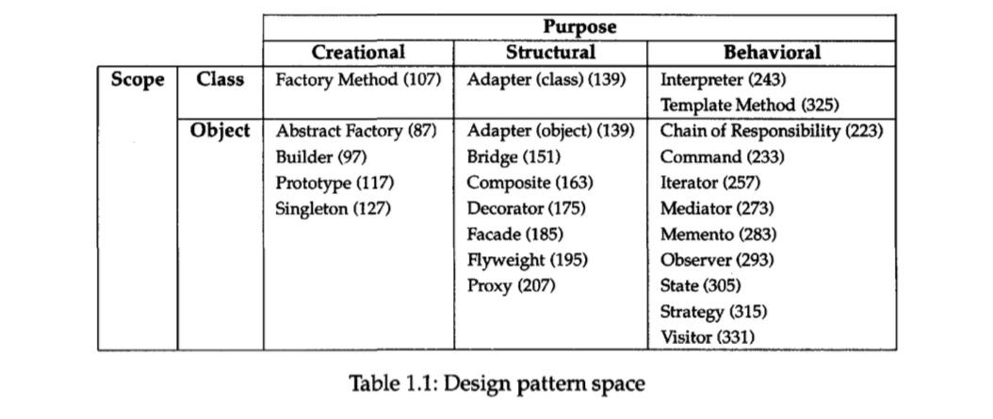
Organizing the Catalog

Slide 15
Organizing the Catalog
Creational patterns concern the process of object creation. Structural patterns deal with the composition of classes or objects. Behavioral patterns characterize the ways in which classes or objects interact and distribute responsibility.
The second criterion, called scope, specifies whether the pattern applies primarily to classes or to objects. Class patterns deal with relationships between classes and their subclasses. These relationships are established through inheritance, so they are staticfixed at compile-time. Object patterns deal with object relationships, which can be changed at run-time and are more dynamic. Almost all patterns use inheritance to some extent. So the only patterns labeled "class patterns" are those that focus on class relationships. Note that most patterns are in the Object scope

Slide 16
How Design Patterns Solve Design Problems
Design patterns solve many of the day-to-day problems object-oriented designers face, and inmany different ways.Here are several ofthese problems and how design patterns solve them.

Slide 17
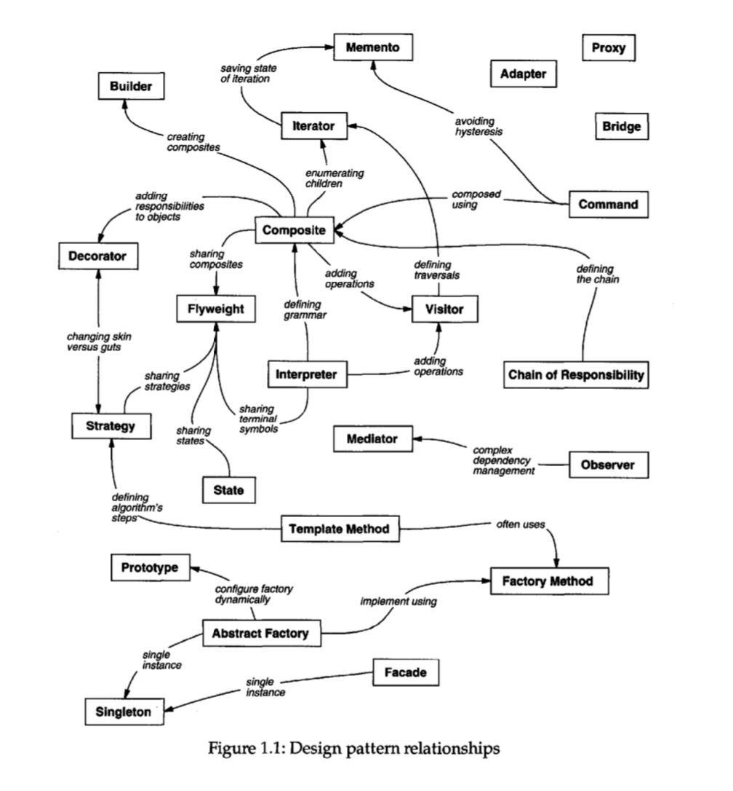

Slide 18
Understanding Object-Oriented Programming
Object-oriented programming (OOP) is based on objects, which combine both data and the operations (methods) that work on that data. An object performs an operation only when it receives a request (message) from another part of the program, called a client. This ensures that an object’s internal data is protected and can only be changed through defined operations. This principle, called encapsulation, keeps an object's internal structure hidden from the outside world, making programs more secure and modular.

Slide 19
The Challenge of Object-Oriented Design
Breaking a system into objects is the most challenging part of OOP. Several factors, such as encapsulation, dependency, flexibility, performance, and reusability, influence this process. Different design approaches exist. Some methods focus on identifying nouns (objects) and verbs (operations) from a problem statement, while others emphasize collaborations and responsibilities within the system. Another approach is modeling the real world, but this can limit flexibility, as real-world concepts may not always match evolving software needs.

Slide 20
The Role of Design Patterns in OOP
Not all objects in a program come directly from real-world models. Some objects, like arrays or high-level abstractions, don’t exist in nature but are essential for designing flexible systems. Design patterns help identify useful abstractions that improve flexibility and reusability. For instance, the Strategy pattern allows interchangeable algorithms, while the State pattern represents different conditions of an object as separate entities. These patterns are usually discovered later in the design process, helping programmers create adaptable and efficient software.

Slide 21
Determining Object Granularity
Objects can vary tremendously in size and number. They can represent everything down to the hardware or all the way up to entire applications. How do we decide what should be an object? Design patterns address this issue as well. The Façade: pattern describes how to represent complete subsystems as objects, and the Flyweight : pattern describes
how to support huge numbers of objects at the finest granularities. Other design patterns describe specific ways of decomposing an object into smaller objects.Abstract
Factory : and Builder: yield objectswhose only responsibilities are creatingother objects. Visitor :and Command :yield objectswhose only responsibilities are
to implement a request on another object or group ofobjects.

Slide 22
Understanding Object Interfaces in Object-Oriented Programming
An interface is a collection of all the operations (methods) that an object can perform. Each operation has a name, parameters, and a return value—this is called the operation’s signature. If an object supports a particular operation, you can send a request (or message) to execute it. The total set of available requests forms the object's interface, which defines what the object can do without revealing how it works internally.

Slide 23
Types, Subtypes, and Polymorphism
A type is a way to describe an object’s interface. For example, an object belongs to the "Window" type if it supports all operations defined in the Window interface. Objects can have multiple types, and different objects can share the same type. If one interface includes another, it is called a subtype, meaning the subtype inherits the behavior of its parent (supertype).
Since an object is known only by its interface, the implementation can vary. Two objects may have the same interface but function differently internally. When a program sends a request, the actual operation that gets executed depends on the receiving object. This is called dynamic binding, meaning the exact method is determined at runtime, allowing flexibility in code execution. This leads to polymorphism, where different objects with the same interface can replace each other without changing the code. This makes programs more modular and easier to maintain.

Slide 24
How Design Patterns Help with Interfaces
Design patterns help structure interfaces by defining what elements to include and how objects interact. For example:
The Memento pattern defines a way to save and restore an object’s state while keeping certain parts private.
The Decorator pattern ensures that a decorated object and its decorator have the same interface, allowing enhancements without modifying existing code.
The Visitor pattern requires its interface to include all possible objects it can interact with.
By following these design patterns, developers can create clear, reusable, and flexible object-oriented systems.

Slide 25
To be continued.....

